Slide 1

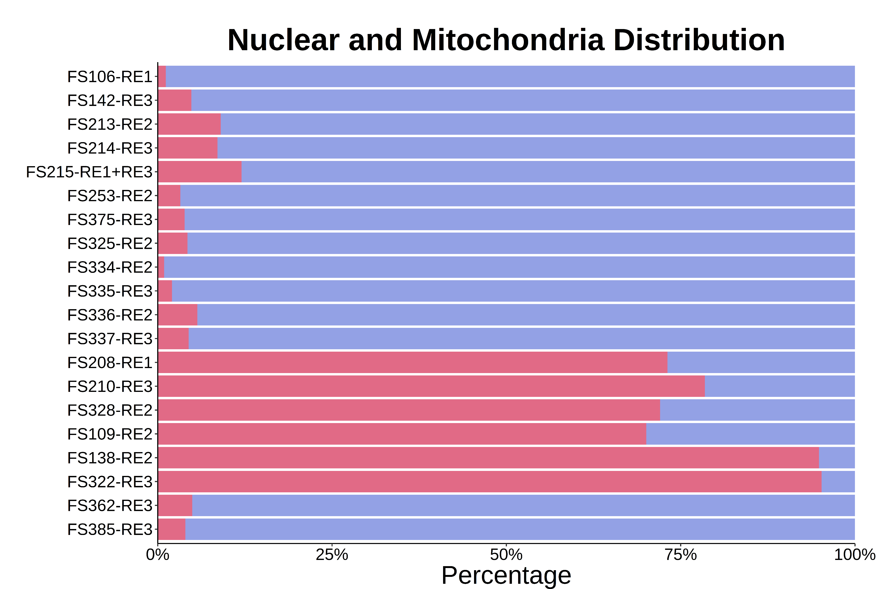
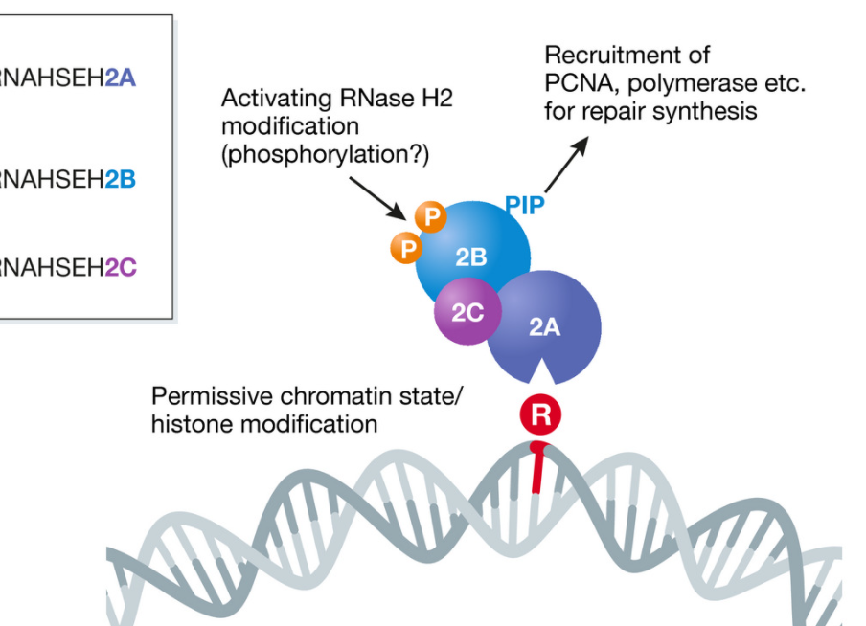
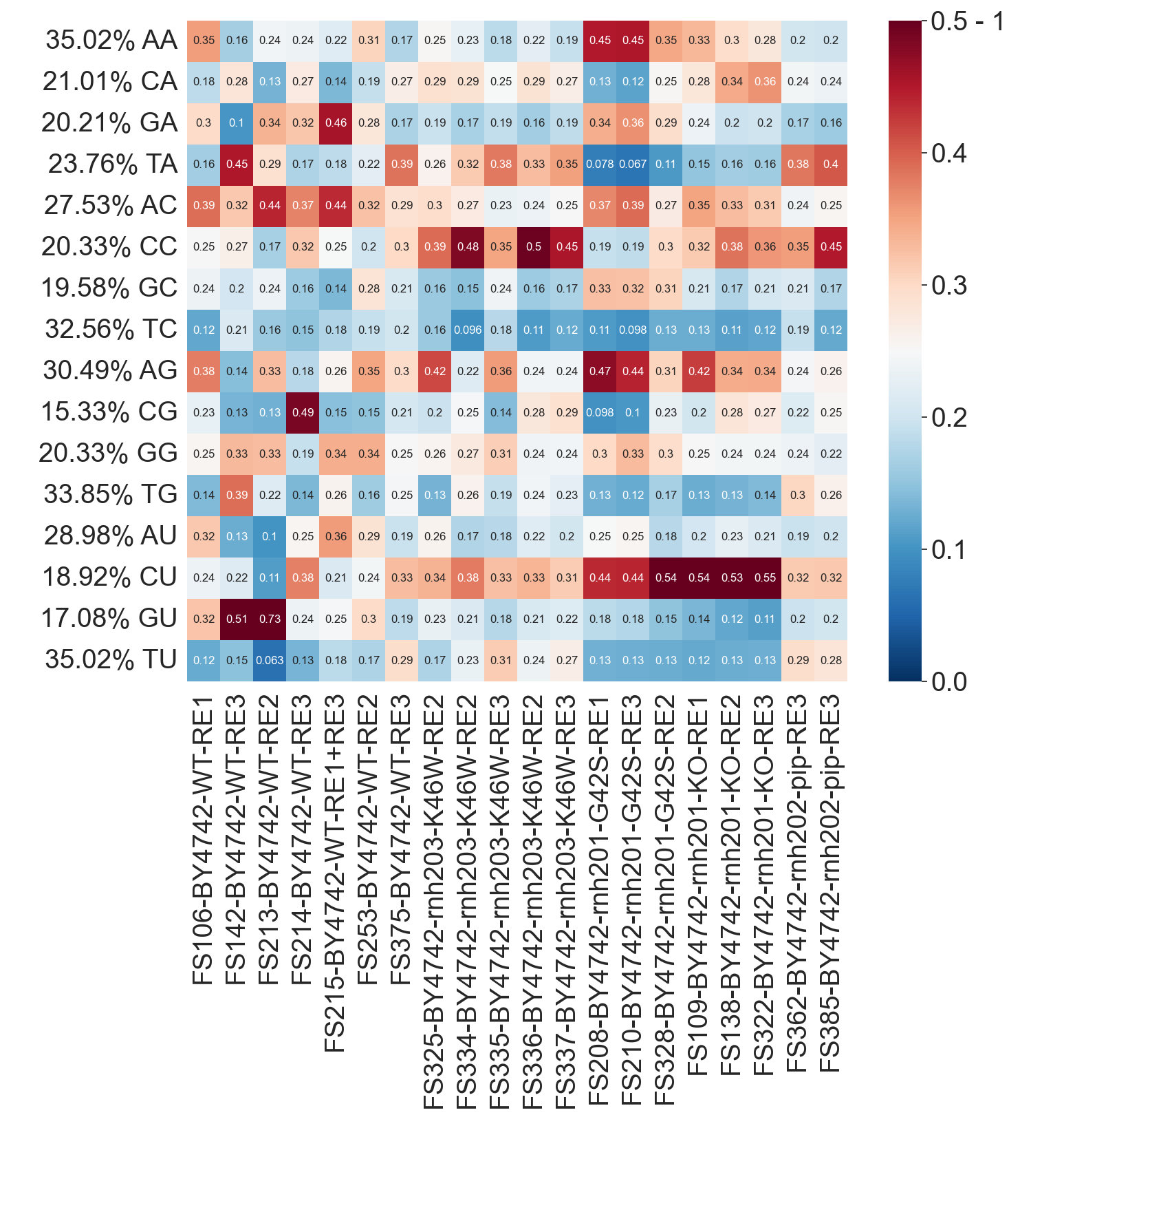
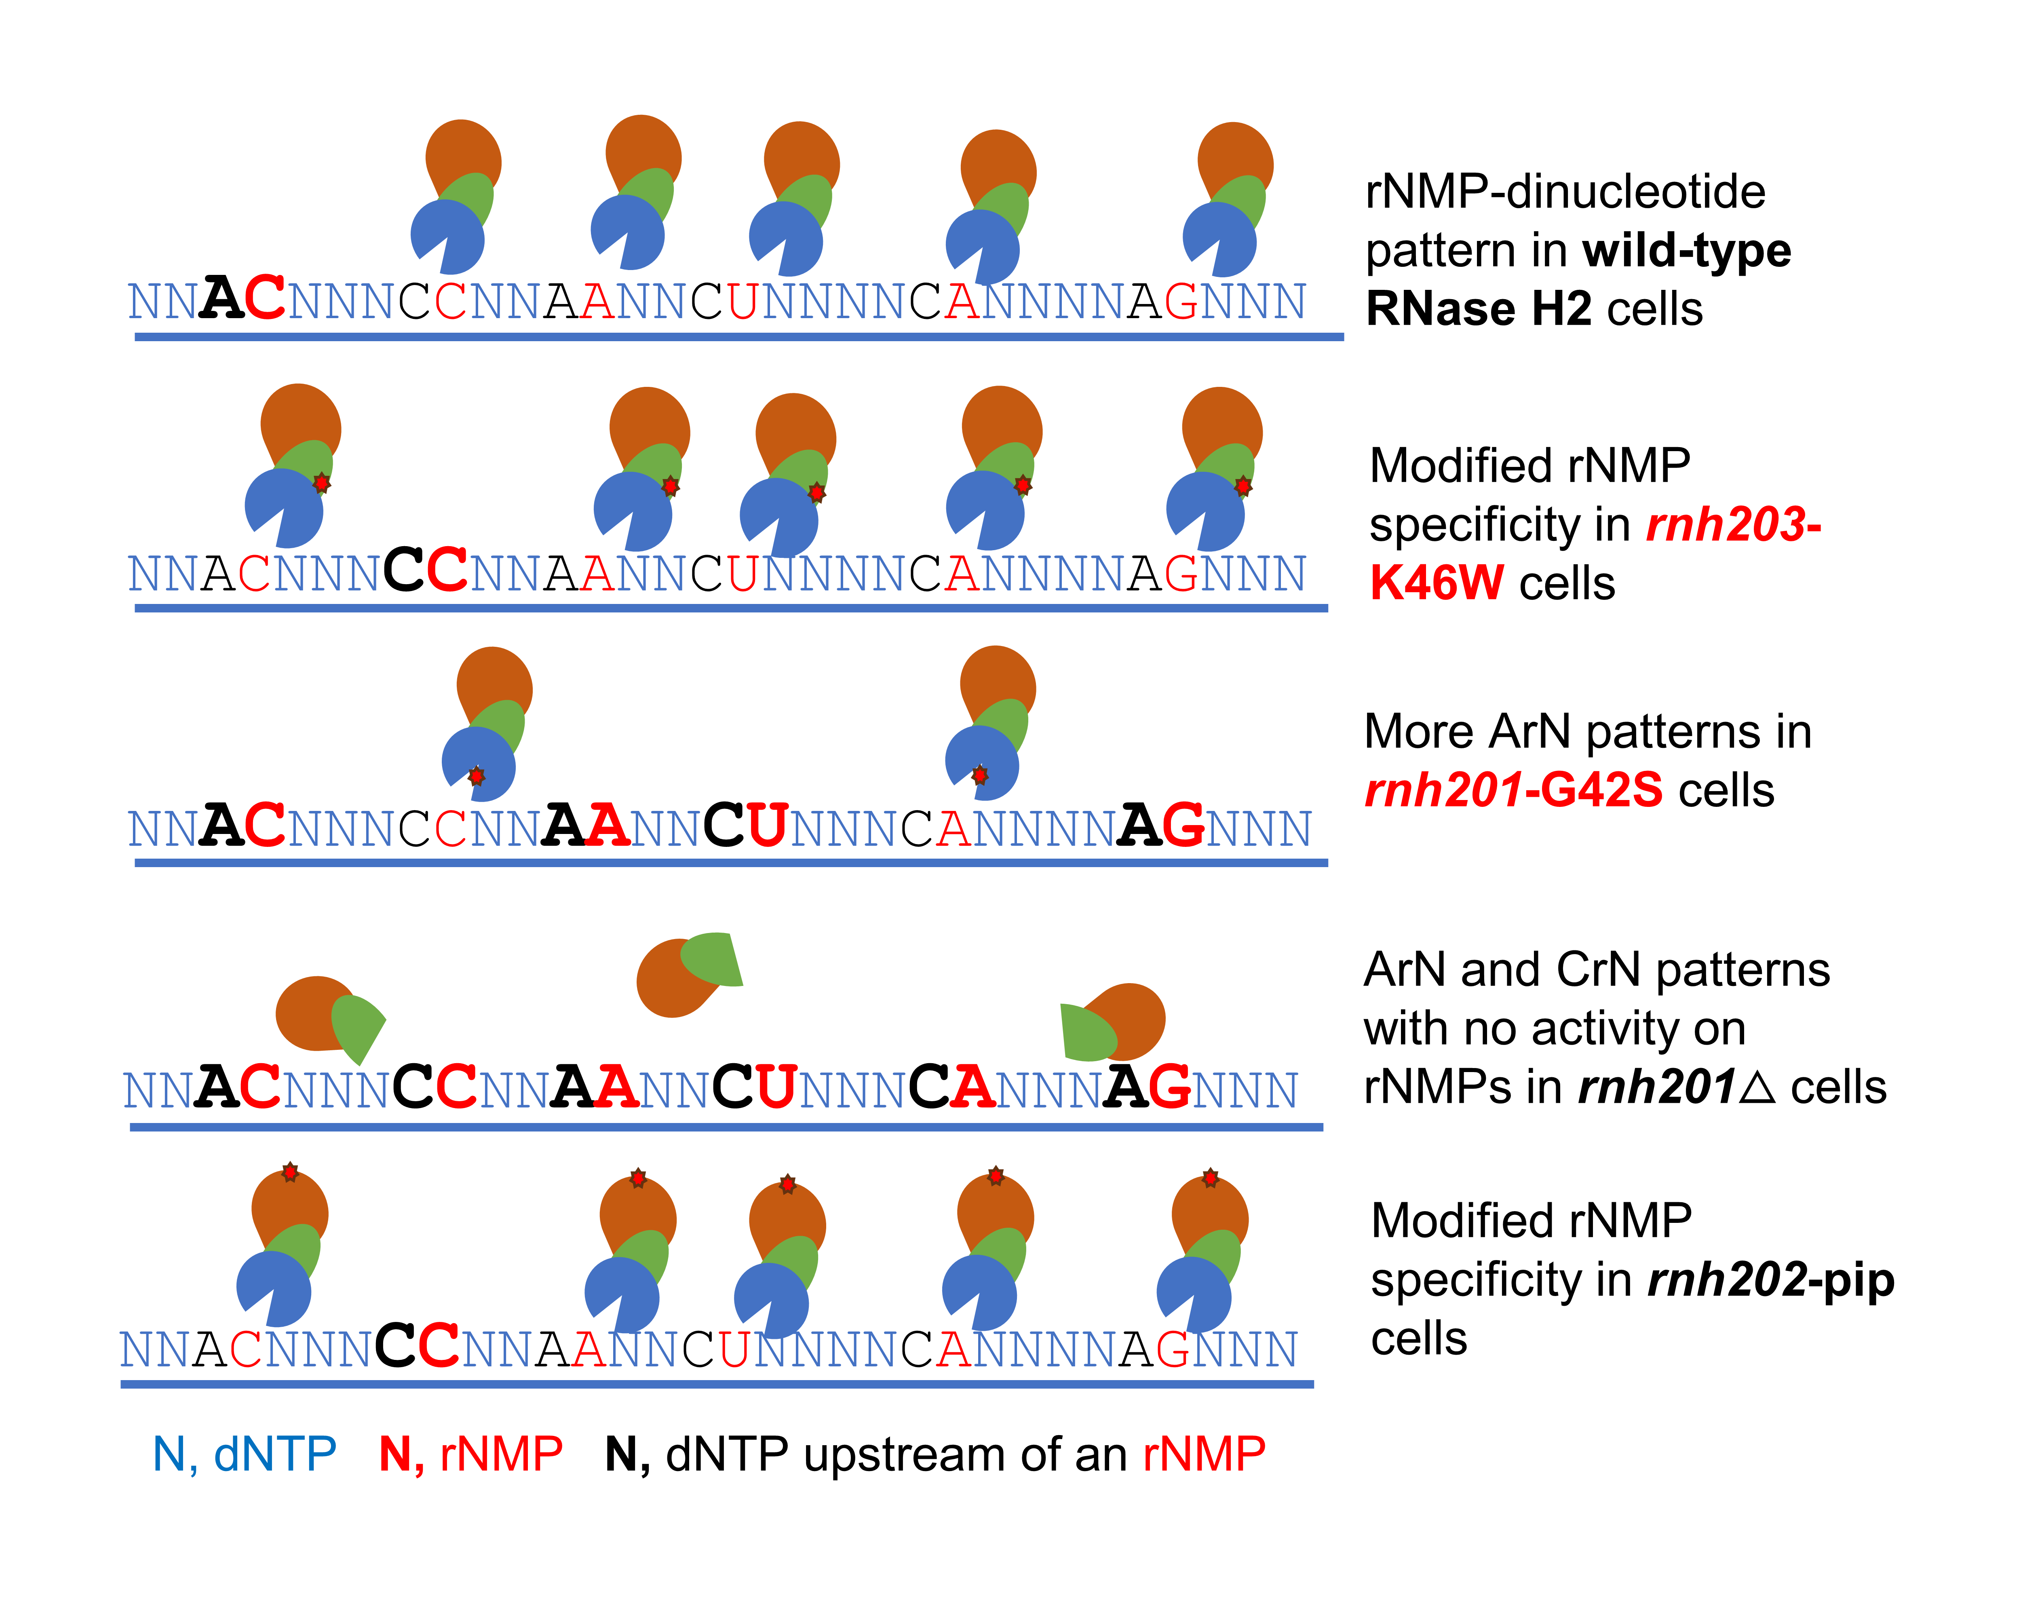
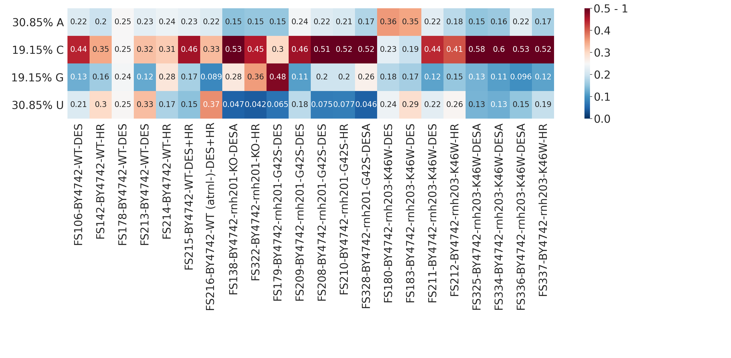
Aicardi–Goutières syndrome (AGS) - orthologous mutation in RNase H2C subunit mimics embedded ribonucleotides patterns of mutation in RNase H2B PIP-box
Genome
Rnh202
rnh201-G42S
Conserved region
Mutations
Amino acid in catalytic site
Nucleus
Rnh203
Human RNH2A
Yeast rnh201
G37S
Mitochondria
Rnh201
Yeast RNaseH2
H.sapiens 1 MDLSELE--RDNTGRCRLSSPVPA---VCRKEPCVLGVDEAGRGPVLGPMVYAICYCPLPRLAD 59
S.cerevisiae 1 MVPPTVEASLESPYTKSYFSPVPSALLEQNDSPIIMGIDEAGRGPVLGPMVYAVAYSTQKYQDE 94
* :* :. ****: ...* ::*:***************:.*. :
WT
rnh203-K46W
G42S
Human RNH2C
Yeast rnh203
R69W
rnh203-K46W
H.sapiens 36 VAVDGPAPVGRFFTPAIRQGPEGLEVSFRGRCLRGEEVAVPPGLVGYVMVTEEK 89
S.cerevisiae 20 TEYQGPTEEFK-------DYKFEDTIYFRGKELKREKPATPSSSDNTTSNTFSN 66
. :**: : : : ***: *: *: *.* . . . * .:
rnh202-pip
K46W
rnh201-G42S
Human RNH2B
Yeast rnh202
rnh201△
H.sapiens 280 ---------AAQKALAKVDKSGMKSIDTFFGVKNKKKIGKV 312
S.cerevisiae 318 LPVKKVTKKIVQNKKPK-VAIGKGAIDGAAKRK-------- 350
.*: * * :** ** *
rnh202-pip
Regulation of RER through human RNase H2
Kellner, EMBO, 2019
PIP
0%
25%
50%
75%
100%
Human G37S -> Yeast G42S is near catalytic domain of RNase H2A
Percentage of rNMPs in nuclear vs. mitochondrial DNA
Human R69W -> Yeast K46W is close to RNase H2A than RNase H2B
NR
Normalized Frequency
WT
rnh203
K46W
rnh201
G42S
rnh201
△
rnh202
pip
Preference for CrC as rnh203-K46W AGS mutants in rnh202-pip mutants
Upstream Nucleotide frequency in Nucleus
Notes:
IEC - intestinal epithelial cells

